Slide 1



QA_Metrics_Only
View in Power BI
Last data refresh:
26/01/2025 20:40:58 UTC
Downloaded at:
26/01/2025 20:43:33 UTC

Slide 2
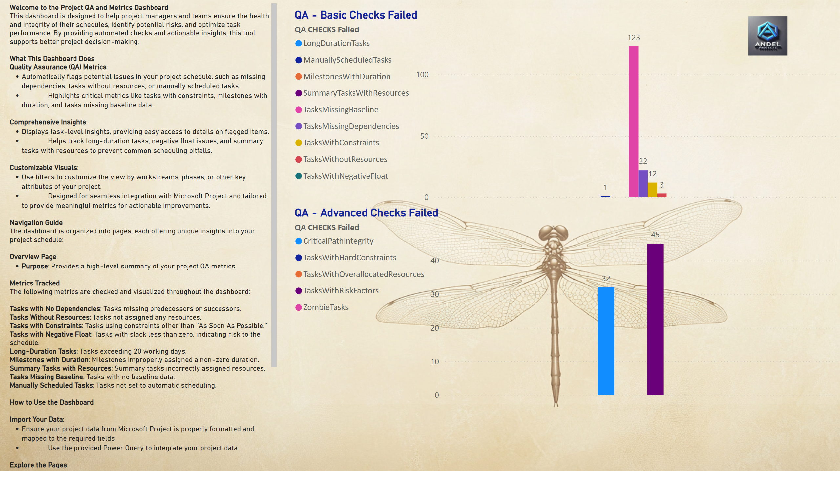
Overview
Notes:
textbox
No alt text provided
QA - Basic Checks Failed
No alt text provided
QA - Advanced Checks Failed
No alt text provided

Slide 3
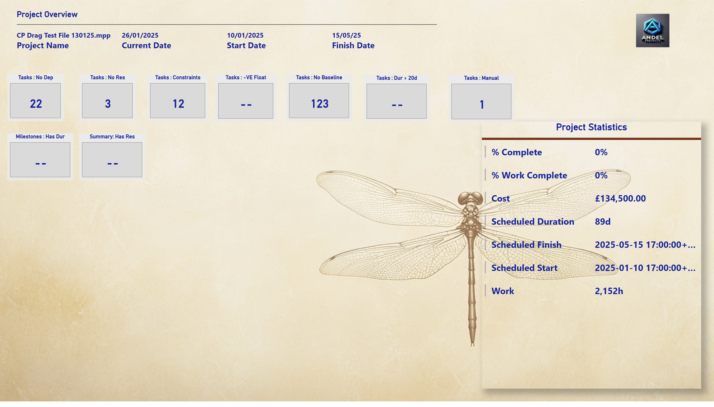
QA Dashboard - Basic
Notes:
Tasks : No Dep
No alt text provided
Tasks : No Res
No alt text provided
Tasks : -VE Float
No alt text provided
Tasks : Constraints
No alt text provided
Tasks : No Baseline
No alt text provided
Tasks : Dur > 20d
No alt text provided
Tasks : Manual
No alt text provided
Summary: Has Res
No alt text provided
Milestones : Has Dur
No alt text provided
Project Overview
No alt text provided
Project Statistics
No alt text provided

Slide 4
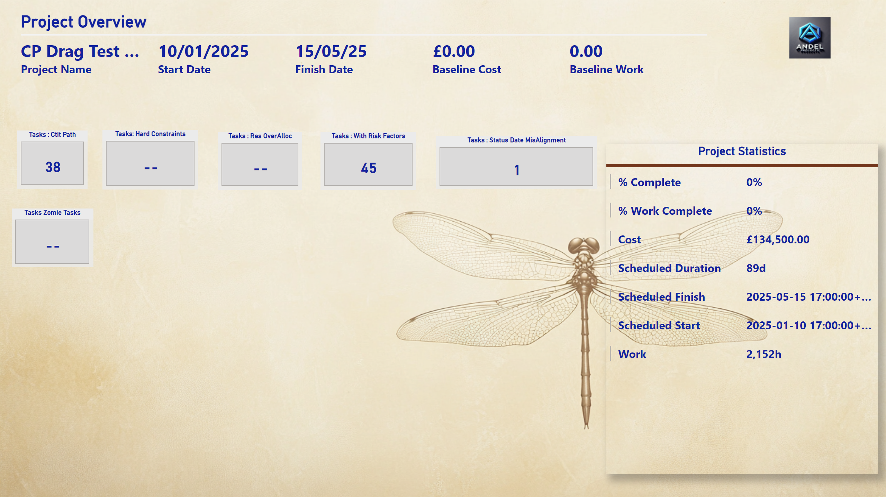
QA Dashboard - Advanced
Notes:
Tasks : Status Date MisAlignment
No alt text provided
Tasks : Ctit Path
No alt text provided
Tasks Zomie Tasks
No alt text provided
Tasks: Hard Constraints
No alt text provided
Tasks : Res OverAlloc
No alt text provided
Tasks : With Risk Factors
No alt text provided
Project Overview
No alt text provided
Project Statistics
No alt text provided

